Slide 1
Deliverable 1
Durham, Hollis, Willis

Slide 2
Vision
Our vision for this project is to make a secure, easy to use e-election software application with the following features:
Easy to use and interact with
Keeps information and votes secure
Allows for immediate voting tally at any time
Unbiased candidate display
Easy to maintain
Quick and easy to understand instructions
We understand each stakeholder has unique requirements and specification for the election software, and we hope to meet each of these. While there may be some speculation around election software, we hope that by outlining exactly how we plan to implement the software we can show confidence in our product. In each of the use cases below, we have outlined what we think each stakeholder will be interested in. These may change after meeting with the client.

Slide 3
Use Cases 1: User is already registered and votes
Scope: Election Software application
Level: user goal
Primary Actor: User
Stakeholders and Interests:
User
Candidates
Government/Business
Field Admin/Proctor
Notes:
User: Want accurate results, the person they votes for to receive a vote, fast and easy-to-use interface, privacy of personal information and who they votes for, quick turnaround on results.
Candidates: Want accurate results, equal representation (alphabetical order, no bold, same fonts), fast and easy to use interface process, quick turnaround on results.
Government/Business: Want inexpensive in terms of resources and management, easy to maintain, accurate results, quick turnaround on results.
Field Admin/Proctor: Want smooth setup, easy to maintain, proper working application, easy to follow instructions, quick process for each user.

Slide 4
Use Case 1 Cont.
Preconditions: Proctor has application up and running, user is registered before current day.
Success Guarantee: Vote is counted, accurate vote, information is secure.
Main Success Scenario (or Basic Flow):
User arrives and logs in at an available computer
Vote *repeat for number of categories
System shows review page of choices
User clicks confirm button on review pages
System logs choices in database, or adds to queue to add to database
“Thank you” page appears indicating user can leave and vote has been processed
User leaves
Special Requirements:
Computer with keyboard and mouse
Processing time for vote to register in database is with 5 mins.
Technology and Data Variations List:
Admin override by keyboard code
Vote by clicking
Log in by entering name and social security number
Frequency of Occurrence: Could be nearly continuous.
Open Issues:
When is voting open?
Extensions (or Alternative Flows):
User is not registered
Wrong login credentials
Trying to vote before time
Application freezes
Notes:
User is not registered
Send user to registration page
Resume voting process
Wrong login credentials
Tell user information is incorrect and have them try again (set number of attempts)
If user cannot login, screen locks and waits for admin
Trying to vote before time
Tells user that it’s too early
Admin would reset screen to home
Application freezes
Databases store after each vote
When the users re-logs in, jumps to unanswered category

Slide 5
Use Case 2: User registers
Scope: Election Software application
Level: user goal
Primary Actor: User
Stakeholders and Interests:
User: Fast and easy to use interface, privacy of personal informations, clear registration information, secure database.
Candidates: Want voters to have a fast and easy registration process, voters given clear registration information so they can vote.
Government/Business: Want Inexpensive in terms of resources and management , easy to maintain, secure database.
Field Admin/Proctor: Want smooth setup, easy to maintain, proper working application, easy to follow instructions, quick process for each user.
Notes:
User: Fast and easy to use interface, privacy of personal informations, clear registration information, secure database.
Candidates: Want voters to have a fast and easy registration process, voters given clear registration information so they can vote.
Government/Business: Want Inexpensive in terms of resources and management , easy to maintain, secure database.
Field Admin/Proctor: Want smooth setup, easy to maintain, proper working application, easy to follow instructions, quick process for each user.

Slide 6
Use Case 2 Cont.
Preconditions: Proctor has application up and running, and user is not registered to vote already.
Success Guarantee: User is able to register to vote, vote is counted, accurate vote, information is secure.
Main Success Scenario (or Basic Flow) :
User arrives
User chooses to register at an available computer
User inputs personal identification (Ex: first name, last name, DOB, SSN, etc.)
User clicks submit to confirm registration
Application tells user they are registered
User is notified that they are not allowed to vote on the same day as registration but is told when they can vote along with when voting ends
User returns to vote on appropriate day
Extensions (or Alternative Flows):
Incorrect Registration Information
Application freezes
Special Requirements:
Computer with keyboard and mouse
Processing time for vote to register in database is within 5 mins.
Technology and Data Variations List:
Admin override by keyboard code
Frequency of Occurrence: Could be nearly continuous.
Open Issues:
When is voting open?
Incorrect information?
Notes:
Incorrect Registration Information
User may be asked to re-enter information is not correct
Application freezes
Application doesn’t store registration data until user clicks submit
If application freezes while user is registering then data is not saved and user is prompted to enter information again

Slide 7
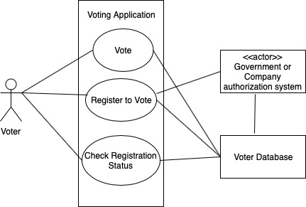
UML Use Case Diagram
Notes:
Where does the admin come in
Proctor?

Slide 8
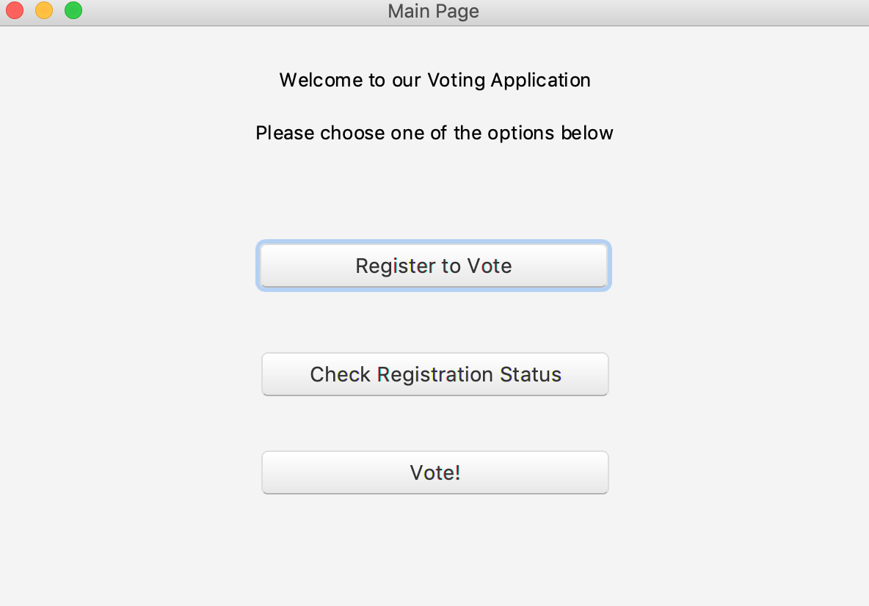
GUI Prototype - Home Screen

Slide 9
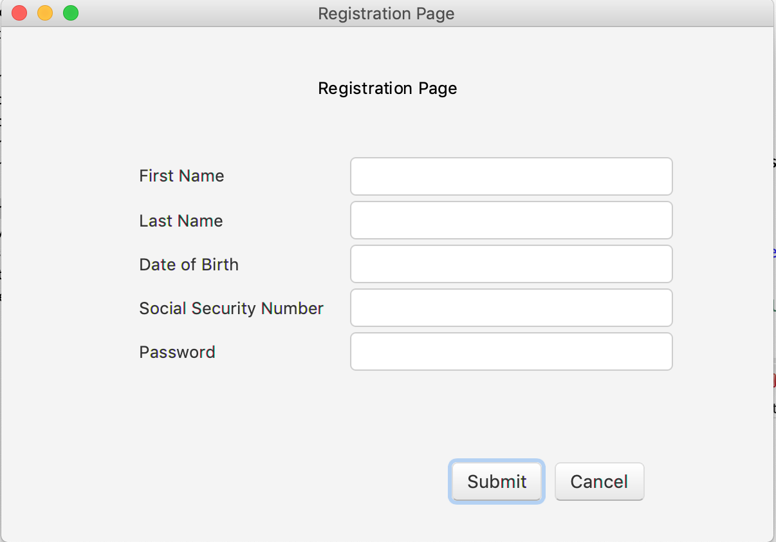
GUI Prototype - Voter Registration Page

Slide 10
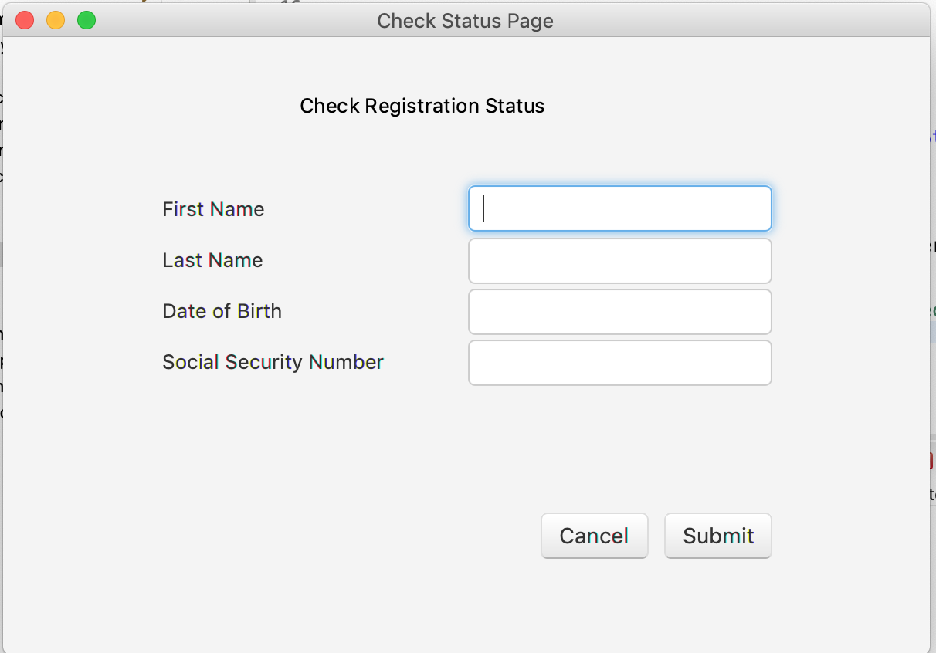
GUI Prototype - Check Registration Status page

Slide 11
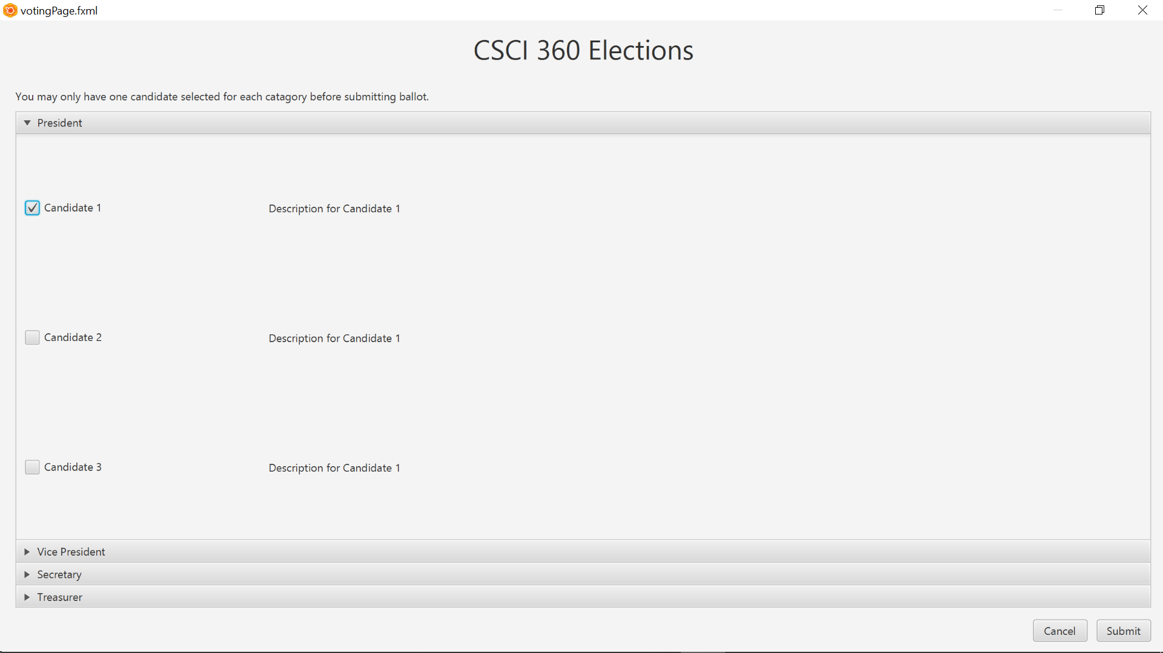
GUI Prototype - Voting Page
Notes:
Won’t have to connect to SSN,
Fake behind it
Extensibility

